Slide 1
Source Science and the Hyperdimensional Nature of Reality
Presented Sat Sept 24, 2016 in Bangalore, India
Quantum Doug Matzke
doug@quantumdoug.com
http://www.quantumdoug.com

Slide 2
Bio for Quantum Doug
Quantum Doug started programming over 45 years ago and started studying metaphysics over 40 years ago. He earned a masters degree in Electrical Engineering with master’s thesis on biofeedback devices in 1980. In 1992 and 1994 Doug was chairman of two PhysComp workshops on physics and computation. In 2002 he earned a Ph.D. in Electrical Engineering with dissertation on quantum computing. He has written over 40 papers and presentations, awarded over 10 patents and won a $1 million SBIR funding to study the connections between neural computing and quantum computing (yes there are many). He is a certified master practitioner in Neuro-Linguistics-Programming (NLP), and trained in multiple “energy” modalities. He meditates regularly and has sung for 40 years.
Doug spoke in Bangalore in 2014 and now he gives an update on his latest work that is going into a new book with co-author Bill Tiller.

Slide 3
What is Source Science?
Based on the latest physics and mathematics, Source Science is a model of humans in the universe that connects information science, quantum physics, mind and metaphysics. Source is generic name for Prana, life force or God.
Thought, awareness, meaning and knowing are as mysterious as consciousness and are just as fundamental since they are all information centric. Likewise normal human intelligence is a mystery (no matter what google says about DeepMind and deep learning). The biggest information science mysteries are genius and savant intelligence plus supernormal psi behaviors. These are all information based so must be built on a quantum like information mechanism that existed “before” classical physics or protophysical. Its no longer about proving anything, its about developing this native mental information technology.

Slide 4
Source of Physical and Non-physical “stuff”
Source Science connects the dual meanings of source:
Source of all physical things: i.e. fields matter, energy, spacetime, gravity, bits, etc.
Modern physics knows that physical really means it is measureable/interacts
Some things are hard to measure: neutrinos, Higgs, spacetime, dark matter, …
Bits are now considered physical, so info/entropy/disorder is physics
All information processes must be part of physics, including thoughts, mind
Source of all non-physical things: i.e. quantum, thoughts, meaning, prana, love, etc.
Parts of physics are not ever measurable: quarks, quantum waves, dark energy, …
Other things effect the world are also not measurable: thoughts, prana, love, …
Thoughts etc. are primary and is the final frontier since is the source code of the universe.
Richard Feynman said: “The world is not classical dammit, it’s quantum mechanical”
“Quantum mechanics is the dreams that stuff is made of” (saying on my favorite t-shirt)
Physical/non-physical distinction is no longer relevant in physics

Slide 5
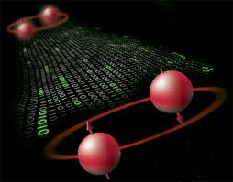
Classical physics emerges from the Quantum Realm
Quantum is more primitive due to these unusual properties (50-100 years):
Fundamentally quantized with wave-particle duality (discrete spin ½, charge , etc.)
Speed of causality is based on quantized energy giving rise to fixed speed of light
Quantum probability amplitudes are mathematical (not field or wave)
Quantum Measurement and wave function collapse
Uncertainty principle, structure of spacetime and zero point energy
Superposition of states and positions (half heads and half tails)
Entanglement is proven even though Einstein called it “spooky action at a distance”
Tunneling is direct result of pervasive quantum probabilities
Superconductivity
Bose-Einstein statistics and condensate – indistinguishable states
Bits are physical and is smallest increment to black hole.
Quantum gravity gives rise to black holes and Hawking radiation
Shor’s algorithm and quantum polynomial time complexity class
My works suggests Higgs, dark matter and dark energy are all 4D and entangled
Impossible for classical physics to give rise to purely quantum behaviors
The most efficient way to simulate a quantum system is to use the quantum

Slide 6
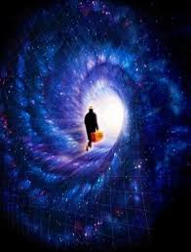
Notable Transpersonal Stories/Technology
Telepathy
Shared Dreams
Animal Whispers
Suzy Miller awesomism and light language
Ester Hicks who channels Abraham about LOA
Personally chatting with 4 leaf clovers and my spoon bending
OBEs, NDEs, remote viewing and dowsing
Robert Monroe: “Journeys of the Body”, OBE pioneer/engineer
Elizabeth Mayer: “Extraordinary Knowing”, if true this changes everything
Harold Puthoff: “Mind Reach”, US government use of remote viewing
Joe McMoneagle, Patricia Cyrus, Randy Z,…: remote viewers I know
Eben Alexander: “Proof of Heaven”, neurosurgeon with NDE
Anita Moorjani: “Dying to be Me”, cured of stage 4 cancer after NDE
Prana Generators
Reiki, acupuncture, pranic healing, kundalini, many other modalities
Intention Host Device: Bill Tiller and Randy Ziesenis
Structured water: Randy Ziesenis, Tony Wood, Revalesio and many others
Vital Energy generator/Tapes: Yuri Kronos
Buddha Relics: Nisha Manek says they change people
REG PK and Outside time behaviors
Many listed on next slide
Touching the Divine is life changing

Slide 7
Thoughts on Thoughts – non-classical requirements
Telepathy is real so represents symbolic meaning without language
Suzy Miller and her light language & Deborah S with “parenthesis around my thoughts”
Humans can directly affect the world (non-local/psychokinesis), most notably:
Electronic REG PK by many groups (Mind Science Foundation, Jahn, Psyleron, …)
Intention Host Device and Gas Discharge by Bill Tiller (water pH and fruit flies)
Twin Slit interferometer PK by Dean Radin
Remote Staring (plus remote viewing and astral projection)
Copper Wall experiments with meditators and TM group mediators
Consciousness shorting out light bulbs and electronics (quantum noise)
Global consciousness project (detected world events before they happened)
Spoon Bending and Japanese Ki/Chi Exhibitions (bending steel rods, etc.)
Levitation (i.e. Transcendental Mediation “hopping” and unliftable marshal artists)
Reiki, pranic healing, intention, prayer, meditation and other therapeutic modalities
if you assume the mind is not the brain, then thoughts affect the brain (normal)
Timeless phenomena: delayed choice, Precognition, 10K photos, retrocausation
Thought are things, but classical models do not explain 1-3 above
Thoughts are really “quantum info things” made from hyperdimensional bits (rotes)

Slide 8
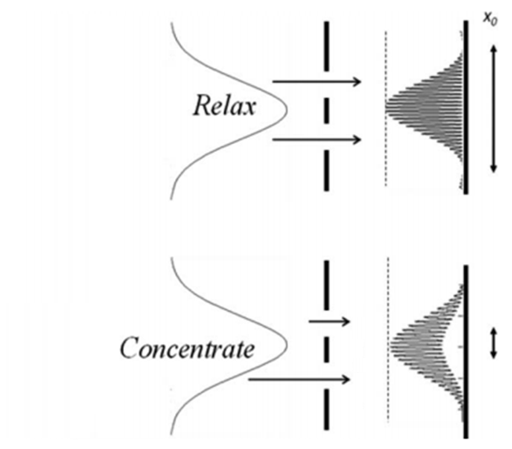
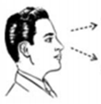
Example: Mind PK directly influencing Quantum States
Enclosed/sealed interferometer
Mind can directly influence quantum amplitudes
No other affects except wave property of light and focus/attention/intention
All PK REGs are the mind influencing the quantum amplitudes/probabilities
Effects size is largest when correlating into the future
Images from Dean Radin

Slide 9
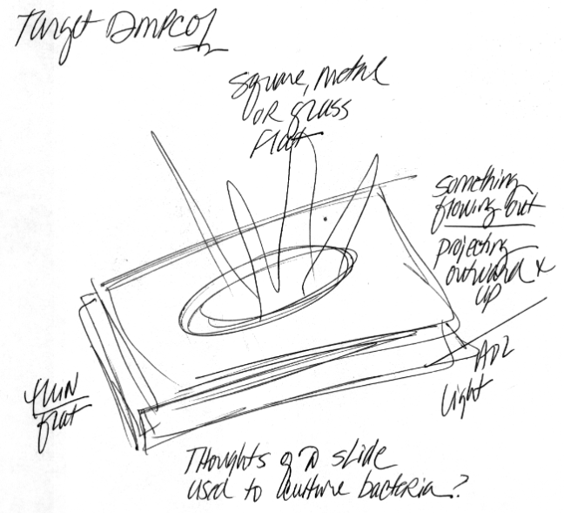
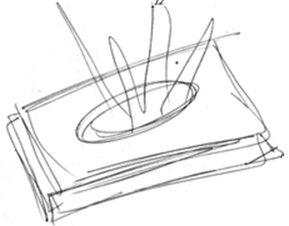
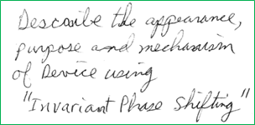
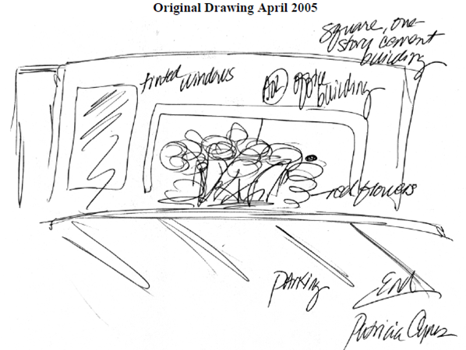
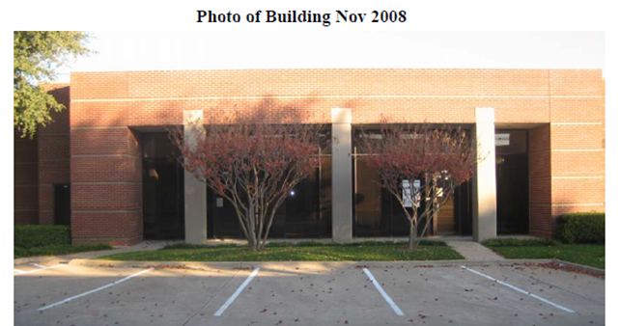
Personal Example of Precognitive Remote Viewing
Patricia Cyrus Target Apr 2005:

Slide 10
No apologies for scientists working on Source/Psi
Past: shamans, Robert Monroe, Robert Jahn, Bill Tiller, Dean Radin, Daryl Bem
Unstated assumptions effect models (nature of spacetime, mind, etc.)
Out of time behaviors can break conventional causal models/protocols
Scientists’ beliefs can affect results (classic particle/wave duality)
Scientists’ attention can affect results (placebo affect requires blinding)
Quantum mechanics showed incompleteness of classical physics
Humans exhibit behaviors not supported by classical models
Information is physical must be extended to include mind/metaphysics
The universe is quantum mechanical, hyperdimensional and bits
Source Science domain is “protophysics”, bits preexisting of spacetime
Subjectivity itself is part of “objective” research (down the rabbit hole)
Skeptics don’t determine the laws of physics, God does ☺

Slide 11
Source Science view of Human Consciousness
Fundamental aspects of mind as known by sages of the ages:
Consciousness, awareness, meaning, knowing, attention, intention & being
Mind is source for awareness, knowing, visual, auditory & emotions (not in brain)
Mind is probabilistic and gestalt with symbols/archetypes (not language)
Mind can focus at any level from subatomic to galactic level awareness & beyond
Mind can focus anywhere and anywhen (not in the classical brain)
Mind is a non-physical information system (universal source code)
Mind is massively parallel and has no limit to complexity increases
Everything is connected with an intrinsic oneness and wholeness
Everything is divine, intelligent and can interact/respond
More than our physical body, magnificent spirit beings having a physical experience
Anu
Source Science goal is to explain these transpersonal/informational mysteries

Slide 12
Source Characteristics
Is informational, but is not a field or wave, nor matter or energy
Freely available since infinite supply
Not in spacetime, but intersects probalistically with spacetime
Not directly measurable, just like quarks, quantum states, …
Observable using mind’s eye (see graphic)
Source filaments show up as “light filaments” (auras, orbs)
Can be mechanically generated (tug on the ether)
Encoded in water, air, IHDs, churches, etc. (naturally/artificial)
When not balanced/flowing gets stuck/heavy in body
Supports awareness, knowing, intelligence and emotions
Feels calm, loving, intimate and divine (magnificent)
Hyperaware and direct knowing of anything, anywhere, anywhen
Being over thinking or action (spacetime/verbnoun balanced)
Where attention goes prana flows

Slide 13
Info Technology is Metaphor of Mind’s Abilities
These technologies are so compelling since they mimic native mind:
Intelligence is ubiquitous and everything can interact (Internet Of Things)
We are all connected as if space/distance does not exist (oneness, sort of)
Google search/Wikipedia are like direct asking/knowing (the akashic records)
Tweets and alerts are like intuition and thought packets (rotes)
Movies are like passively watching emotionally engaging dreams
Digital Video recorders, replay and slow motion are like warping time
Virtual reality and gaming are like lucid dreaming
Video calling, sonograms, medical scanners, satellites are like remote viewing
Tweets, email and social media sharing are like rotes/telepathy
Telepresence and drone 3d video goggles are like astral projection
3D printer technology is like direct manifestation
Medical technology is like innate healing

Slide 14
Info Requirements for Source Science Model
Source Science must identify thought information representation that:
Does not depend on matter/energy
Transcends space/time (nor any derived space/time properties, i.e. frequency, …)
Is Turing complete (can compute anything)
Is Quantum computing complete (consistency, holistic, probabilistic & entangled)
Is Shor complete (supports Shor’s algorithm which implies hyperdimensional!!)
Is Von-Neumann balanced (no differentiation of data/program or space/time)
Allows self organization in spite of entropy (perhaps source of negentropy)
Allows robust (probabilistic) interaction of mind with the physical world
Everything can be arbitrarily interconnected (holographic does not meet above)
Does not have a complexity limit (allows genius, savant and infinite intelligence)
Quantum states meet these requirements (with some explanation)

Slide 15
Cleaning up our language/thinking (NLP 101)
Language terms that do not work if spacetime metrics don’t apply:
Dimensions: our 3d+1t continuous spacetime is emergent from primitive protodimensions/bits
Frequency or Fourier transforms: none in quantum realm, only parallel states: use term “vibrational”
Field or waves: Since no space or frequency, then no propagation of fields (EM or gravity)
Energy: is really a well defined physics term, so shouldn’t be applied here since is ST metric
Subtle energy: is a category error, so prefer terms source or prana (we don’t use the term subtle mass)
Entropy: is a statistical measure of disorder, but if no spacetime then entropy must be rethought
Von Neumann Computing is data (for space) and programs (for change): is not verbnoun balanced
Language terms to be avoided for hyperdimensional spaces:
Distance: same formulas now mean similarity or correlation
Duration: no global or relativistic time only primitive state change independent of any others
Non-local: There is no distance, so something local in 4 dimensions appears non-local in 3D
Faster-than-light: if a back door is taken in other dimensions, then is instantaneous or infinite velocity
Center of a black hole: diameter of black hole is exactly 0 (singularity with max length contraction)
Entropy: Complexity increases without using energy, so is source of negentropy (are two sources)
Holographic: holograms reduce dimensionality but not possible to reduce hyperdimensional states

Slide 16
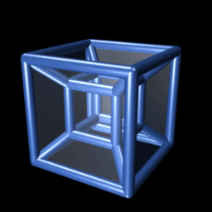
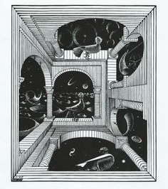
Source Science Foundations from Physics/Math
Information is Physical (not just mathematical)
Rolf Landauer: Erasing information loses energy (measured in 2014)
John Wheeler: “It from Bit” since a bit is smallest change to a black hole
Bits are physical and have an effective energy and an equivalent mass
Reality is Hyperdimensional (not 3 space + 1 time dimensions)
Bits, qubits and ebits are very real with essential novel behaviors
Bit is one dimensional and is used to make qubits and ebits
Qubit is quantum primitive for superposition with 2 private bit dimensions
Ebit is quantum primitive for entanglement with 4 private bit dimensions
Shor’s algorithm uses 2¹⁰⁰⁰ states to compute faster than any classical computer
Thoughts are quantum things (not in the brain)
Thoughts are “information things” and intentions affect the physical world.
Thoughts can “directly” affect REG PK devices in the physical world (even brain)
Solution required to show how non-physical mind can influence order/disorder

Slide 17
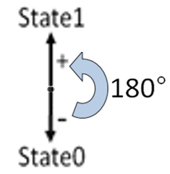
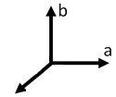
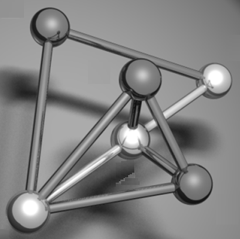
Source Science is Informational and Protophysical
Bits are the smallest quanta identified by physics, so we’ll start there:
Each bit is orthonormal vector (geometric algebra not in spacetime)
Qubit (spin ½) is formed with 2 bit vectors (not in spacetime)
Qutrit is 3 bit vectors standard model quarks/leptons/bosons appear
Ebits are entanglement of 2 qubits (with 4 bit dimensions, no spacetime)
When >20 bits, content addressable memory properties emerge
Bit equivalent Black holes are formed when a large sun collapses
Empty Spacetime is discrete quantum ether formed from “quantum foam”
c
+
-
John Wheeler’s “it from bit” spans the small to the big

Slide 18
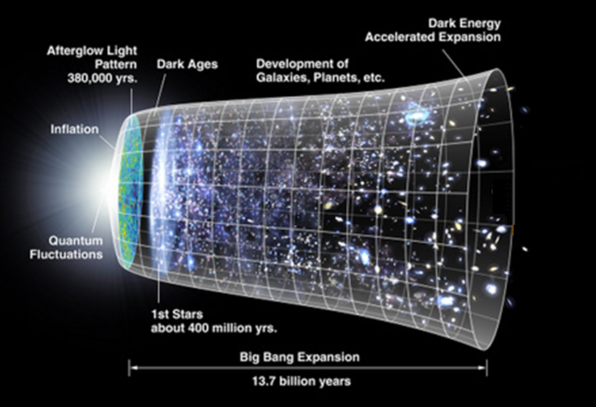
Protophysics is “before physics” of big bang
First Singularity created
the big bang
Time itself
Space and inflation
Energy/fields
Matter/gravity
“before” big bang event
bit bang
Quantum states - Bits
Highly specialized state where dimensions united creating S/T/E/M
a big thought?

Slide 19
Protophysics - emergence of Space and Time
Co-occurrence means states exist simultaneously: Space-like via “+” operator
Co-exclusion means a change occurred due to an operator: Time-like via “*” operator

Slide 20
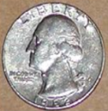
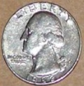
Energy of Big Bang from Bits: Coin Demo: Act I
Setup:
Person stands with both hands behind back
Act I part A:
Person shows hand containing a coin then hides it again
Act I part B:
Person again shows a coin (indistinguishable from 1st)
Act I part C:
Person asks: “How many coins do I have?”
This represents one bit: either has 1 coin or has >1 coin

Slide 21
Coin Demo (continued)
Act II:
Person now holds out hand showing two identical coins
We receive one bit since ambiguity is resolved!
Act III: co-occurrence
Asks: “Where did the bit of information come from?”
Answer: Simultaneous presence of the 2 coins!
Landauer Principle: info creation = effective Energy
Non-Shannon space-like information derives from simultaneity!

Slide 22
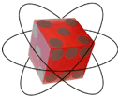
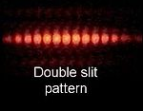
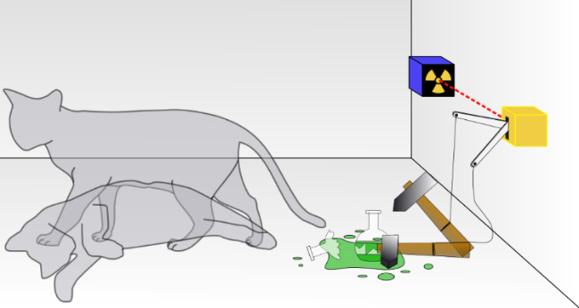
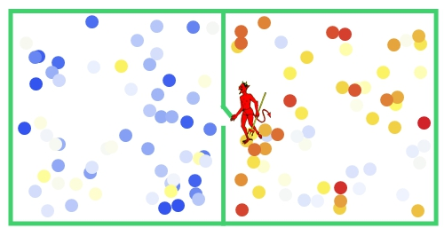
Statistics and Source Science
Probabilities are intrinsic (or global knowledge or for all time)
Quantum states are statistical due to superposition
Schrodinger’s cat (what scale does superposition end?)
Classical statistics – randomness and countable states
Bose-Einstein statistics – countable indistinguishable states
Bell statistics – correlations above classical statistics (non-local)
Retrocausation statistics – correlations above classical statistics
Statistics, Infor and Entropy – Maxwell’s demon
CAMS/Correlithms and standard distance/radius
Shor’s algorithm requires infinite precision floating point numbers.
The mind is source code programming the probabilities

Slide 23
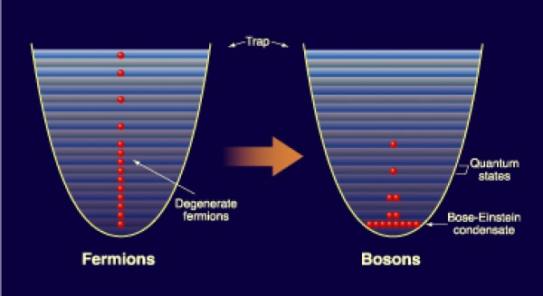
How do Fermions and Bosons know to do this?
Fundamental topology must create these rules

Slide 24
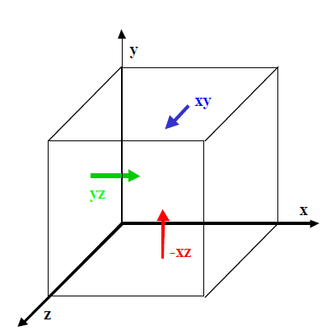
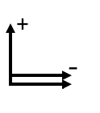
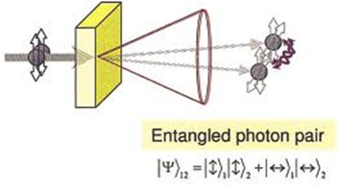
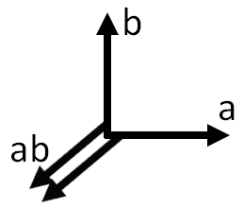
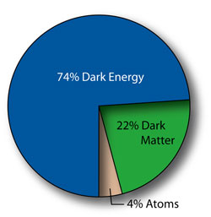
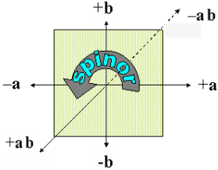
What are quantum states? – geometric algebra 101
Bit – 1 dim
Qubit - 2 dims
Ebit - 4 dims
Qutrit - 3 dims (stnd model)
a
bc
c
Photons
quaternions
Quarks
+
+
+
-
-
Quarks: ± w ± xy
Dark Quarks: ± w ± xyz
3 orientations ±1, 0
-
+
2x
$$⊗$$
a0+a1
-
b0+b1
Orthonormal vectors
bivectors
Dark matter/energy- 4 dims
Bell Operator
𝓣_{i} = S_{A} + S_{B} =
a0 a1 + b0 b1
+
a+b+ab
Dark Quarks*
-
Co-occurrence generates information/energy
$$↻$$
*Entangled States
𝓣_{j} = –a0 b0+a1 b1
Higgs Boson* (ℋ² = 0)
ℋ = 𝓣_{i} + 𝓣_{j} + 𝓣_{k}
Dark matter* (4 dquarks) (some 𝓓² = 0)
𝓓 = {(±w ±xyz) + (±x ±wyz)
+ (±y ±wxz) + (±z ±wxy)}
qubits and neutrinos
3 tauquernions

Slide 25
Particles X²=1 (Unitary) in Geometric Algebra
Find all Unitaries in 𝔾 using: gasolve([a,b, ...], lambda X: X*X, 1)
Space | Count | Unitary Multivector | Particle Description
𝔾₁ | Total 2 | ± a | Exclude scalar value of ±1
𝔾₂ | Total 12 |  | (qubit space)
 | 4 | ±x | Vectors are distinctions
 | 8 | ±a ±b ±ab | Neutrinos (predict 4 not 3)
𝔾₃ | Total 90 | *quarks are: ±x ±yz | (Standard model Space)
 | 6 | ±x | Vectors are distinctions
 | 24 | ±x ±y ±xy | Neutrinos (3x8=24)
 | 12 | ±xy ±xz | Electrons (3x4=12)
 | 48 | ±x ±y ±z ±xy ±xz | Protons (neutrons = xyz protons)
𝔾₄ | Total 12,690 |  | 17 Different signatures
 | 10 | ±x and ±wxyz | Vectors and Mass Carrier
 | … | … | 16 more signatures
For X² = X (Idempotent) and U² = 1 (Unitary) then X = –1 ± U (proof X² = (–1 ± U) ² = X)

Slide 26
Bosons X²=0 (Nilpotents) in Geometric Algebra
Find all bosons in 𝔾 using: gasolve([a,b, ...], lambda X: X*X, 0)
Space | Count | Boson Multivector | Boson Description
𝔾₀ & 𝔾₁ | Total 0 | Exclude 0 from this table | 0²=0
𝔾₂ | Total 8 |  | (qubit space)
 | 8 | ±x ±xy = ±x*(1 ± y) | Weak Force Bosons W/Z
𝔾₃ | Total 80 | *quarks are: ±x ±yz | (Standard model Space)
 | 8 | ±a ±b ±c | Photonic Boson (Qutrit)
 | 24 | ±x ±xy | Weak Force Bosons in 𝔾₃
 | 8 | ±ab ±ac ±bc | Quaternions are bosonic
 | 24 | ±x ±z ±xy ±yz | Mesons are two quarks
 | 16 | ±x ±y ±z ±xy ±xz ±yz | Strong Force (Gluons)
𝔾₄ | Total 7,280 |  | 30 Different signatures
 | 80 | ±x ±xy and ±w ±xyz | Weak and Dark Bosons
 | 528 | (ab - cd) + (ac + bd) + (ad - bc) & … | 16 Higgs Boson & others
 | … | … | 28 more signatures
𝔾₃ is equivalent to Pauli Algebra and 𝔾₄ contains Dirac Algebra. Also Parsevals Identity

Slide 27
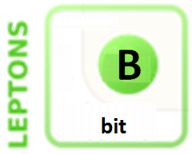
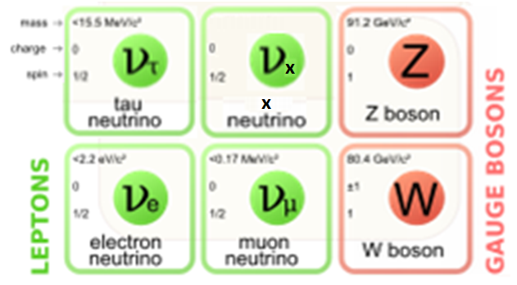
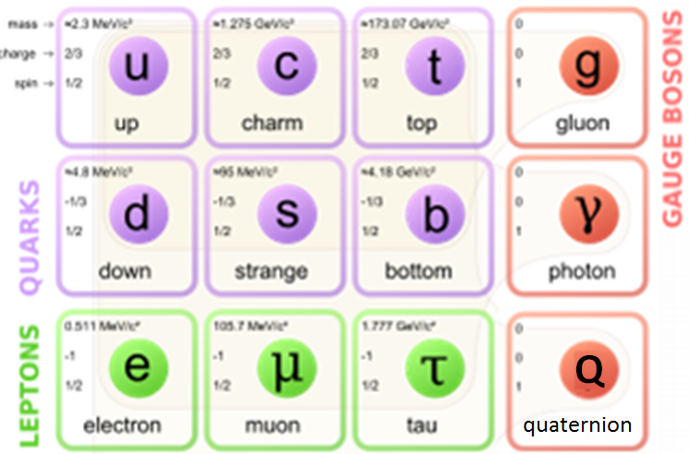
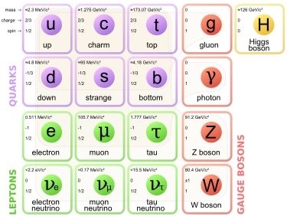
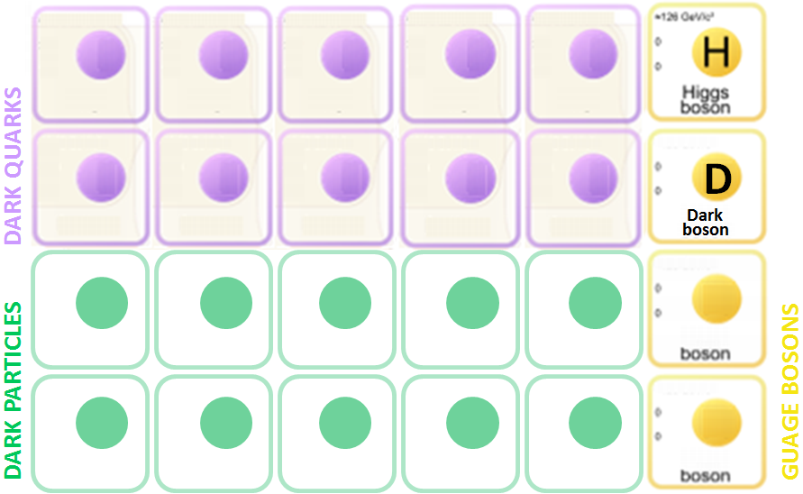
Organizations of Primitive “Particles”
Non-Standard Topological Model (from Manthey and Matzke - ANPA)
Bit in G₁
primitives in G₂ plus qubit
primitives in G₃
9 states
Standard Model (from Wikipedia - SU3 symmetry)
81 states
6561 states
primitives in G₄
>43 million states
17 particles and
30 bosons

Slide 28
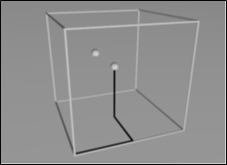
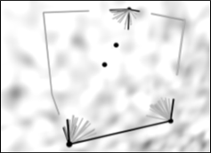
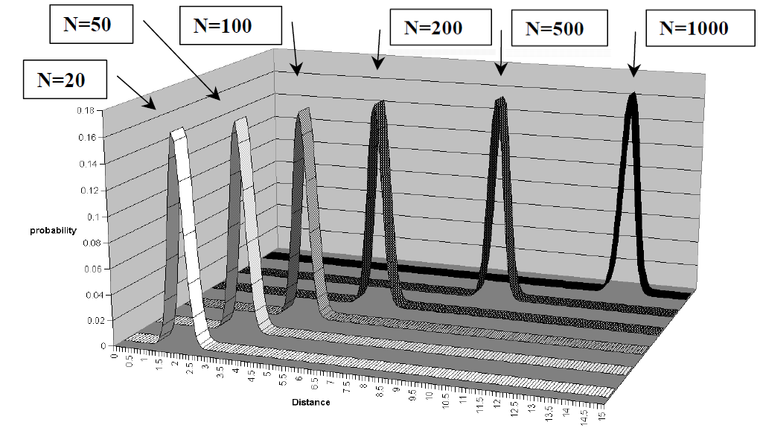
Content Addressable Memories 101
Pick a random point P in a 3 dimensional space – easy
Pick a random point P in a 100 dimensional space – hard
Pick 2nd point Q in a each space – compute distance
Pick 3rd point X in a each space – compute distances
Find the distances have an average value and deviation
For dimensions N>20 and Middle point M:
Distance PQ is $\sqrt{N/6}$ (standard distance)
Standard dev of PQ is $\sqrt{7/{120}}$ (independent of N)
Distance PC or QC is $\sqrt{N/{12}}$(standard radius) &$\sqrt{1/{60}}$
For big N standard distance/radius are constants
Intrinsic similarity measure (equivalent to light year in physics)
Also know as sparse distributed coding or correlithms and related to CDMA, spread spectrum

Slide 29
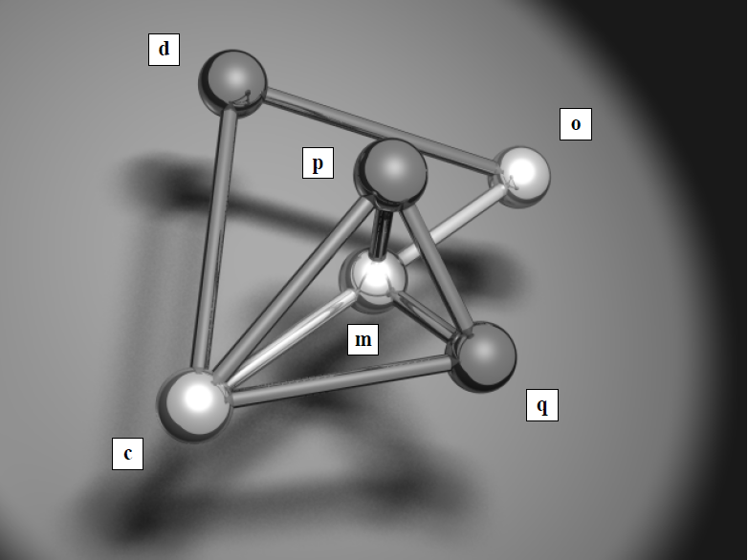
Unusual probabilistic geometries from randomness
Points | Raw Distance | Normalized Distance
MQ=MP | $\sqrt{N/{12}}$ (radius) | 1
PQ | $\sqrt{N/6}$ (distance) | $$\sqrt{2}$$
MC=MO | $$\sqrt{N/4}$$ | $$\sqrt{3}$$
CP=CQ | $$\sqrt{N/3}$$ | $$\sqrt{4}$$
DC=DO | $$\sqrt{N/2}$$ | $$\sqrt{6}$$
CO | $$\sqrt{N}$$ | $$\sqrt{12}$$
P
standard
distance
12 dims is special since MP = 1
M = mid/null/void point
stnd
radius
$$\sqrt{2}$$
1
M = middle
C = corner
O = opposite corner
D = random corner
P/Q = random points
Big thought vectors built from small vectors are orthogonal in hyperdimensional spaces. This is the mathematics of law of attraction.
M
Q
1

Slide 30
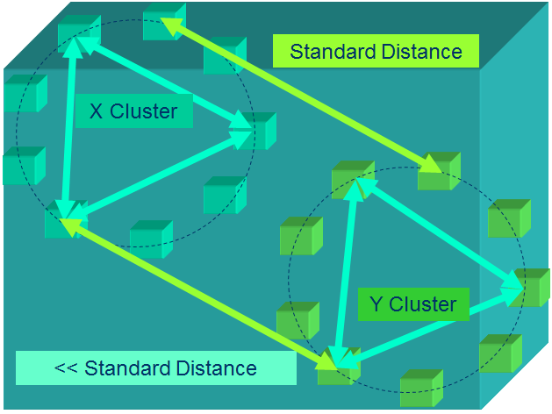
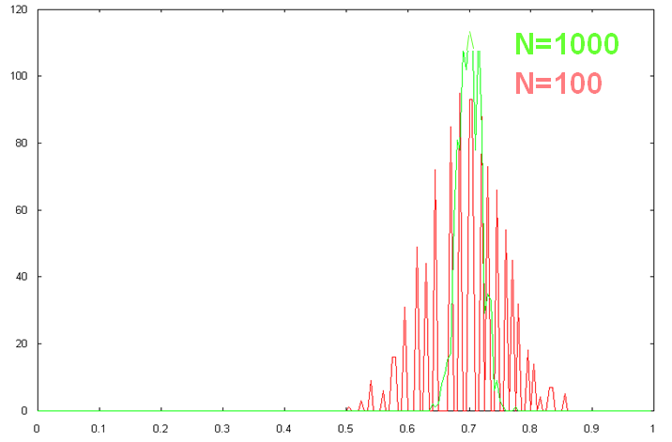
Quantum CAM – uniform distributed-phase ensembles
Start with 2 ensembles A&B each of 1000 qubits – all with random phase
Start with 2 measurement a&b ensembles (1000) each with random phase
Remember all those starting phases to repeat in each trial
Repeatedly Measure A with a and B with b measuring distance vs last one
Repeated (A.a)₁ dist (A.a)₂ is 70% of stand dist compared to (A.a)₂ dist (B.b)₂
Distinguish A from B even with random phases
Mechanism for Quantum Mind interacting with the brain as antenna

Slide 31
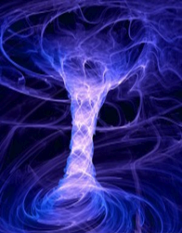
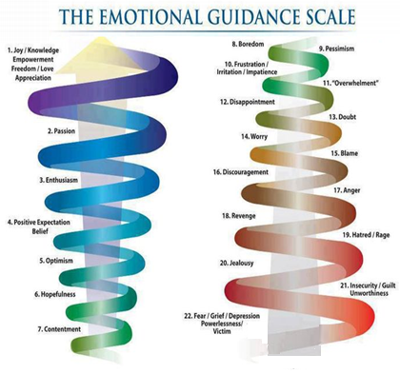
Law of Attraction – CAM math
Like attracts Like (requires meaning based matching)
Like things are near each other – High dimensional Vortex (no hologram)
Inclusion based universe (can't push thoughts away)
All cooperative components are assembling in LOA thought region
Content addressable memory is mathematics of LOA (address=data)
Massive contributions to big thought vectors – The Vortex
Neural correlates feeding CAM thought bit vectors
Thoughts controlling neural/synapse firings
Visual, Auditory, emotional structures states/chemicals
Gender and Hormonal contributions to emotions/chemicals
DNA contributions – Morphic Resonance
Breathing, grounding, Chakras and auric bodies
CAM/LOA has superposition and info based probabilistic clouds
NLP style anchoring creates emotional superpositions
Emotional Guidance scale – choosing the lighter observer frame
Parallel thoughts rather than sequential thinking (no spacetime)

Slide 32
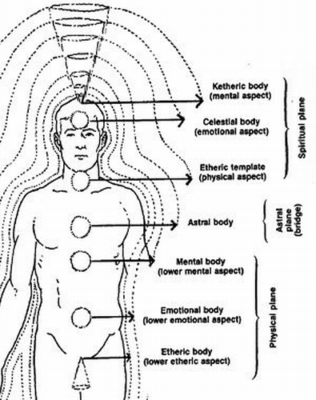
Prana, Chakras, Auras and Auric Bodies
Mental
Emotional
Physical
Bridge
Mental
Emotional
Physical
Auras, orbs and chakras are real and show up on film!

Slide 33
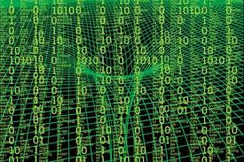
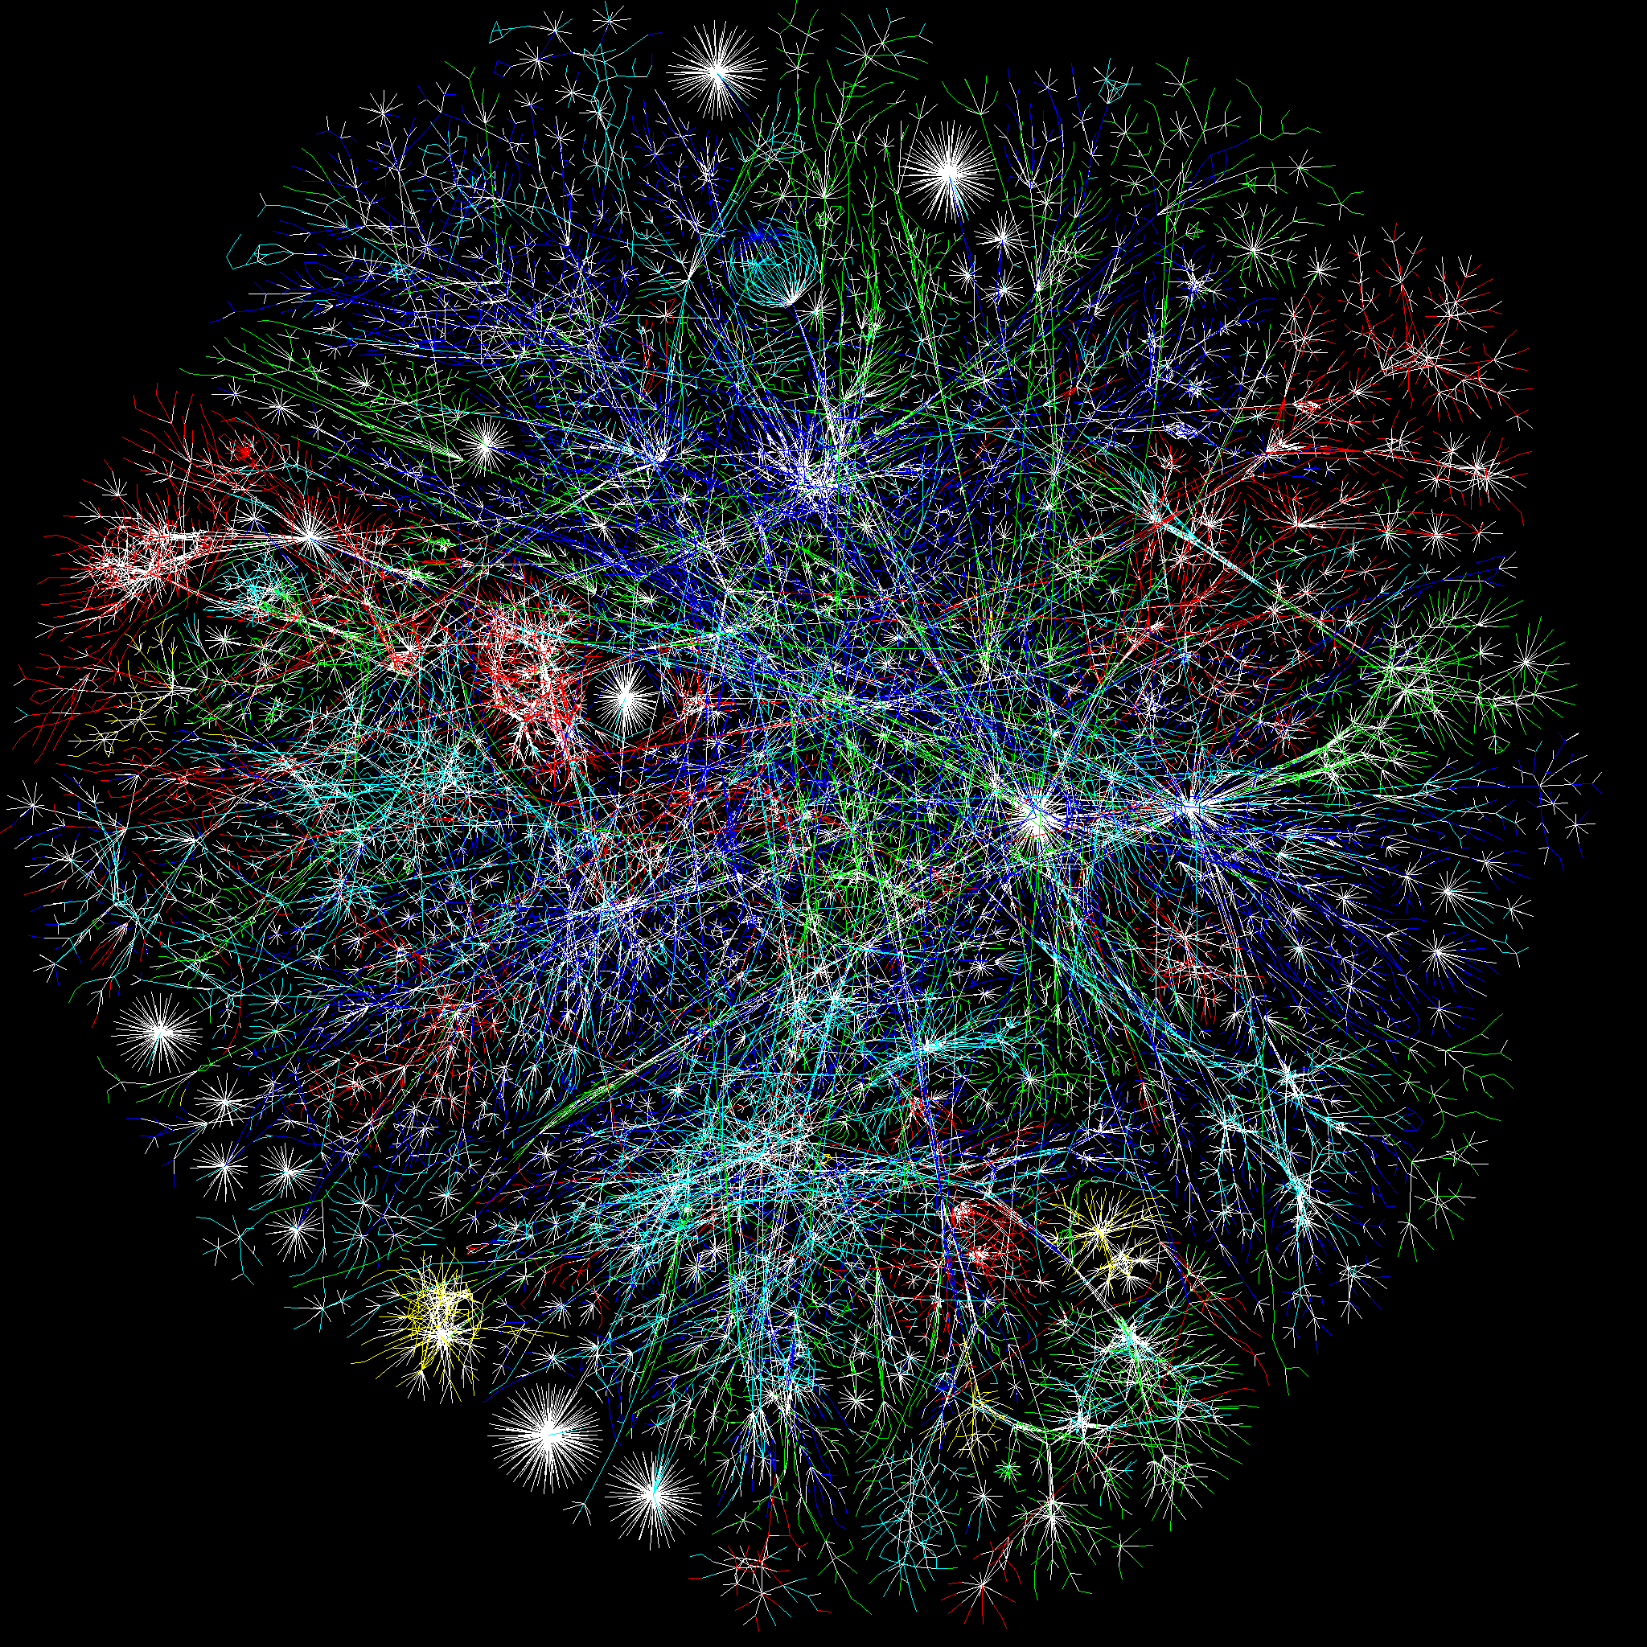
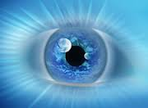
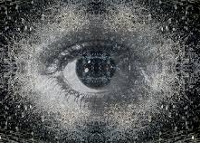
Quantum Matrix: Mind is the Source Code
Mind’s eye is the ultimate observer
Universe simulated from hyperdimensional foam
Hyperdimensional bit-vectors outside space and time

Slide 34
Source Science: What does it all mean?
Reality is hyperdimensional quantum matrix (bit-vectors)
Hyperdimensional bit-vectors is the consistency substrate of quantum mechanics
Hyperdimensional bit-vectors precede space, time, frequency, energy, matter, fields, gravity
Entire classical world emerges from this hyperdimensional quantum foam (GA & coin demo)
This infrastructure supports all of physics, quantum physics and metaphysics (protophysics)
Law of attraction is naturally part of the hyperdimensional space
Content Addressable Computing is mathematics of hyperdimensional clustering
Similarities naturally forms clusters that form the vortices (a pre-spacetime gravity well)
All thoughts are “big” orthogonal CAM vectors so has no complexity limits
Mind is native in this hyperdimensional information centric representation
Quantum thoughts are naturally orthogonal and parallel (sequential is not the norm)
Fundamentals: awareness, attention, intention, knowing, meaning, being, consciousness
Mind is root of visual, auditory, feelings, emotions (quantum matrix not in the brain)
Neural, chemical, dna, emotional, pranic states focal point of mind (dominate = Th/Em/Pr)
Thoughts are directly aware/interact with the physical world (Telepathy, RV, OBE, NDE, PK)

Slide 35
Source Science Predictions
Here are technology/devices/techniques that are/could be developed:
Training wheels to help release from our brains (Lucid dreaming, RV, OBE)
Telepathy enhancers/training
Directly access intuition/knowing, so less reliant on internet data
Directly experience the divine and know we are connected (no religions)
Significant increases in our intelligences (mental, emotional, spiritual)
High gain PK devices (ebrains) that we could learn to control
Calming state generators (change emotional landscape of mankind)
Truly effective and approved healing techniques/technologies
Interactions with more advanced aware beings (self, angels & aliens)
Unbelievably advanced technology (last 150 yrs. will seem prehistoric)
Acceptance of Source Science ideas, funding, research and development

Slide 36
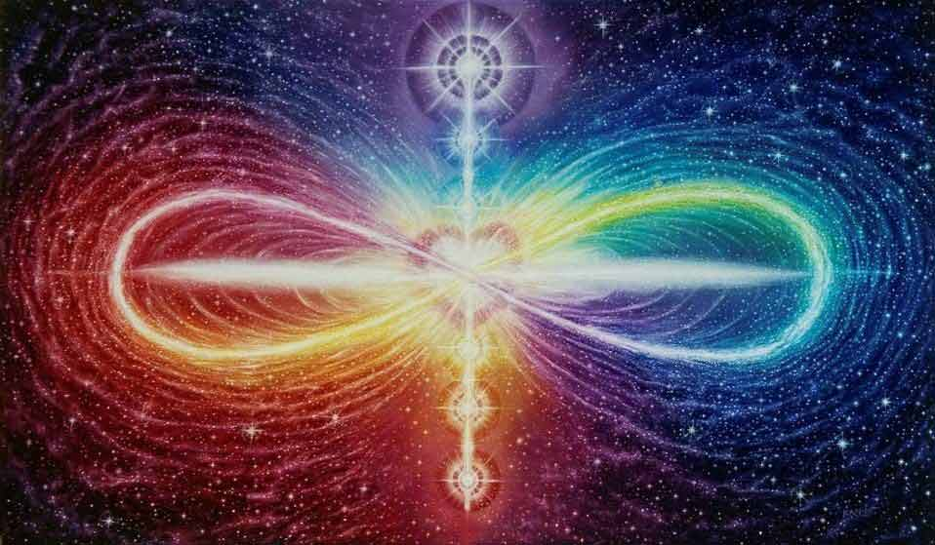
Source Science Big Picture for Humans
Magnificent spiritual beings having a physical experience
Source/mind is the source code of the universe
Source/mind/soul is outside brain and spacetime
We are more than our physical bodies
We are all one and eternal (unity and panoramic time)
Source/mind/prana is real, unobservable, intelligent, knowing
Source/mind represents profound joy and love, Source is love
Source is god stuff, so we are source
We are angels
We are god
I am god
I am

Slide 37
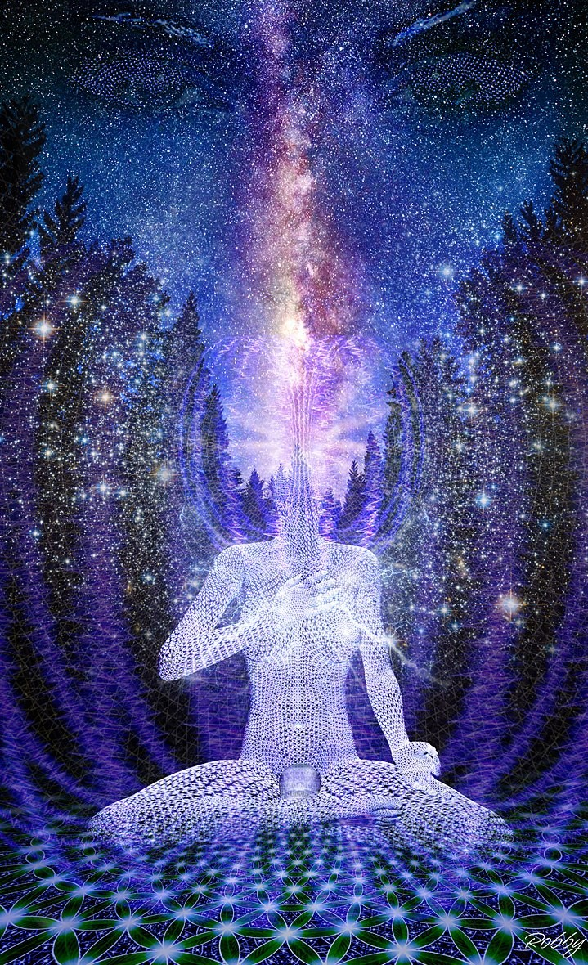
We are spiritual beings and more than our body
Traditional view of Mind as Machine
Source Science view of Mind/Reality

Slide 38
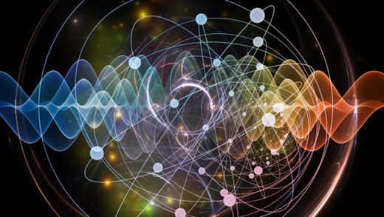
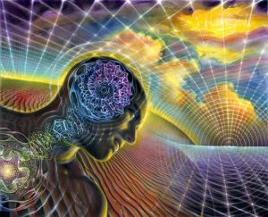
Questions and Answers
Please ask your questions about Source Science
doug@quantumdoug.com
http://www.quantumdoug.com
https://www.facebook.com/QuantumDoug

